Slide 1
Activity Demo
MainActivity.kt
activity_main.xml
SecondActivity.kt
activity_second.xml
AndroidManifest.xml

Slide 2
MainActivity.kt
package com.example.yourapp
import android.content.Intent
import androidx.appcompat.app.AppCompatActivity
import android.os.Bundle
import android.view.View
import android.widget.Button
import androidx.compose.ui.semantics.Role.Companion.Button
class MainActivity : AppCompatActivity() {
override fun onCreate(savedInstanceState: Bundle?) {
super.onCreate(savedInstanceState)
setContentView(R.layout.activity_main)
val button = findViewById<Button>(R.id.button)
button.setOnClickListener {
val intent = Intent(this, SecondActivity::class.java)
startActivity(intent)
}
}
}

Slide 3
activity_main.xml
<?xml version="1.0" encoding="utf-8"?>
<RelativeLayout xmlns:android="http://schemas.android.com/apk/res/android"
xmlns:tools="http://schemas.android.com/tools"
android:layout_width="match_parent"
android:layout_height="match_parent"
tools:context=".MainActivity">
<Button
android:id="@+id/button"
android:layout_width="wrap_content"
android:layout_height="wrap_content"
android:text="Open Second Activity"
android:layout_centerInParent="true"/>
</RelativeLayout>

Slide 4
SecondActivity.xml
package com.example.yourapp
import androidx.appcompat.app.AppCompatActivity
import android.os.Bundle
class SecondActivity : AppCompatActivity() {
override fun onCreate(savedInstanceState: Bundle?) {
super.onCreate(savedInstanceState)
setContentView(R.layout.activity_second)
}
}

Slide 5
activity_second.xml
<?xml version="1.0" encoding="utf-8"?>
<RelativeLayout xmlns:android="http://schemas.android.com/apk/res/android"
xmlns:tools="http://schemas.android.com/tools"
android:layout_width="match_parent"
android:layout_height="match_parent"
tools:context=".SecondActivity">
<TextView
android:id="@+id/textView"
android:layout_width="wrap_content"
android:layout_height="wrap_content"
android:text="This is the Second Activity"
android:layout_centerInParent="true"/>
</RelativeLayout>

Slide 6
AndroidManifest.xml
<?xml version="1.0" encoding="utf-8"?>
<manifest xmlns:android="http://schemas.android.com/apk/res/android"
xmlns:tools="http://schemas.android.com/tools" >
<application
android:allowBackup="true"
android:dataExtractionRules="@xml/data_extraction_rules"
android:fullBackupContent="@xml/backup_rules"
android:icon="@mipmap/ic_launcher"
android:label="@string/app_name"
android:roundIcon="@mipmap/ic_launcher_round"
android:supportsRtl="true"
android:theme="@style/Theme.AppCompat"
tools:targetApi="31" >

Slide 7
AndroidManifest.xml
<activity
android:name="MainActivity"
android:exported="true"
android:label="@string/app_name"
android:theme="@style/Theme.AppCompat" >
<intent-filter>
<action android:name="android.intent.action.MAIN" />
<category android:name="android.intent.category.LAUNCHER" />
</intent-filter>
</activity>

Slide 8
AndroidManifest.xml
<activity
android:name="SecondActivity"
android:exported="true" >
<intent-filter>
<action android:name="android.intent.action.MAIN" />
<category android:name="android.intent.category.LAUNCHER" />
</intent-filter>
</activity>
</application>
</manifest>

Slide 9
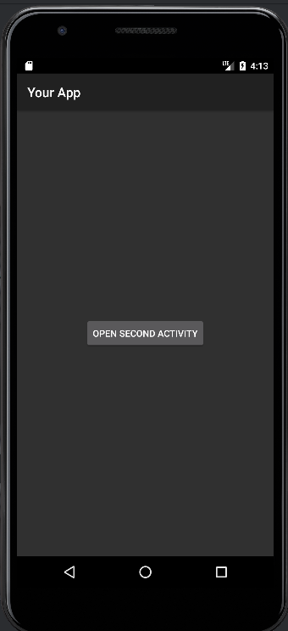
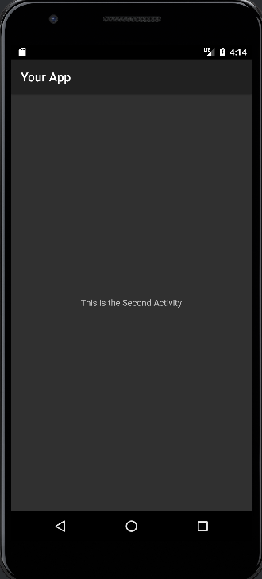
Output:

